Slide 1

Object Oriented Programming
Prof. Dnyaneshwar Kanade

Slide 2
What is Object Oriented Programming (OOP)?
Object Oriented programming (OOP) is a programming paradigm that relies on the concept of classes and objects.
It is used to structure a software program into simple, reusable pieces of code blueprints (usually called classes), which are used to create individual instances of objects.
There are many object-oriented programming languages including JavaScript, C++, Java, and Python.

Slide 3
The Need of OOP
The main aim of OOP is to bind together the data and the functions that operate on them so that no other part of the code can access this data except that function.
Object-oriented programming aims to implement real-world entities like inheritance, hiding, polymorphism etc in programming.

Slide 4
Characteristics of object-oriented languages
Polymorphism
Inheritance
Encapsulation
Abstraction

Slide 5
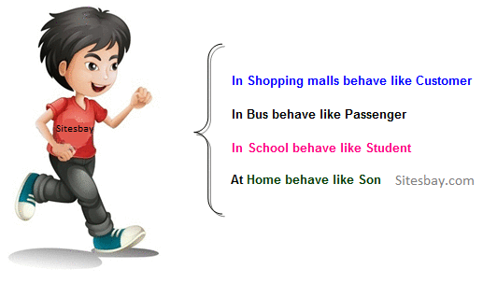
Polymorphism
Polymorphism refers to the ability of OOPs programming languages to differentiate between entities with the same name efficiently.

Slide 6
Inheritance
Inheritance is an important pillar of OOP(Object Oriented Programming). It is the mechanism in java by which one class is allowed to inherit the features(fields and methods) of another class.
Super Class: The class whose features are inherited is known as super class(or a base class or a parent class).
Sub Class: The class that inherits the other class is known as subclass(or a derived class, extended class, or child class). The subclass can add its own fields and methods in addition to the super class fields and methods.

Slide 7
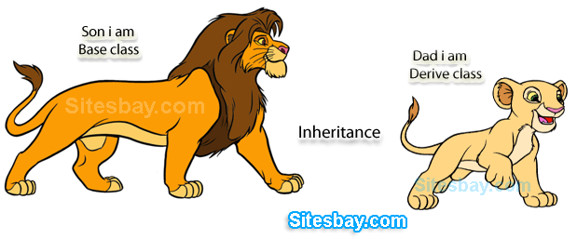
Inheritance

Slide 8
Inheritance
Reusability: Inheritance supports the concept of “reusability”, i.e. when we want to create a new class and there is already a class that includes some of the code that we want, we can derive our new class from the existing class.
By doing this, we are reusing the fields and methods of the existing class.

Slide 9
Encapsulation
Encapsulation is defined as the wrapping up of data under a single unit.
It is the mechanism that binds together code and the data it manipulates.
Another way to think about encapsulation is, it is a protective shield that prevents the data from being accessed by the code outside this shield.

Slide 10
Abstraction
Data Abstraction is the property by virtue of which only the essential details are displayed to the user.
The trivial or the non-essentials units are not displayed to the user. Ex: A car is viewed as a car rather than its individual components.

Slide 11
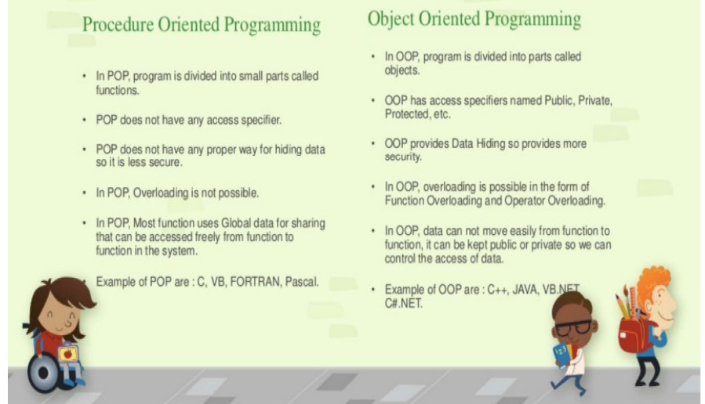
Why OOP is better than Procedural?

Slide 12
Classes and Objects
A class is a template for an object, and an object is an instance of a class.
Because an object is an instance of a class, you will often see the two words object and instance used interchangeably.
The most important thing to understand about a class is that it defines a new data type.
Once defined, this new type can be used to create objects of that type.

Slide 13
Classes and Objects
When we define a class, we declare its exact form and nature.
We do this by specifying the data that it contains and the code that operates on that data.
Simple classes may contain only code or only data, most real-world classes contain both.
A class is declared by use of the class keyword.

Slide 14
Classes and Objects
A simplified general form of a class definition is shown here:
Data Type
Name of Variable
Return Type
Name of Method
Code
Parameters Passed

Slide 15
Classes and Objects
The data, or variables, defined within a class are called instance variables.
The code is contained within methods.
Collectively, the methods and variables defined within a class are called members of the class.
Example

Slide 16
Classes and Objects
Variables defined within a class are called instance variables because each instance of the class (that is, each object of the class) contains its own copy of these variables.
Thus, the data for one object is separate and unique from the data for another.

Slide 17
A Simple Class
Variables defined within a class are called instance variables because each instance of the class (that is, each object of the class) contains its own copy of these variables.
Thus, the data for one object is separate and unique from the data for another.

Slide 18
A Simple Class
Here is a class called Box that defines three instance variables: width, height, and depth.
As stated, a class defines a new type of data.
In this case, the new data type is called Box.
We will use this name to declare objects of type Box.
It is important to remember that a class declaration only creates a template; it does not create an actual object.

Slide 19
A Simple Class
To actually create a Box object, you will use a statement like the following:
Box mybox = new Box(); // create a Box object called mybox
After this statement executes, mybox will refer to an instance of Box. Thus, it will have “physical” reality.
Each time we create an instance of a class, we are creating an object that contains its own copy of each instance variable defined by the class.

Slide 20
A Simple Class
Thus, every Box object will contain its own copies of the instance variables width, height, and depth.
To access these variables, you will use the dot (.) operator.
The dot operator links the name of the object with the name of an instance variable.
For example, to assign the width variable of mybox the
value 100, we would use the following statement:
mybox.width = 100;

Slide 21
Example
Call the file that contains this program BoxDemo.java, because the main( ) method is in the class called BoxDemo, not the class called Box.

